Slide 1


What do you mean by “is”?
What does “state” mean in a distributed / microservices architecture
Duncan Jones
💬 @Merrion

Slide 2

Local & deterministic
* Well defined unambiguous state

Slide 3

“Service” level
* Some hiding and/or aggregation of state

Slide 4
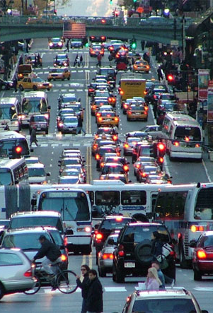
“System” level
* Is there a state here?
It depends…

Slide 5

“Time” the disruptor
The state may have changed,
while you were observing it

Slide 6

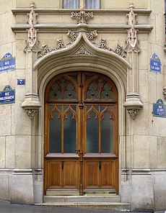


The “hotel room” example
Is anyone in room 303?

Slide 7
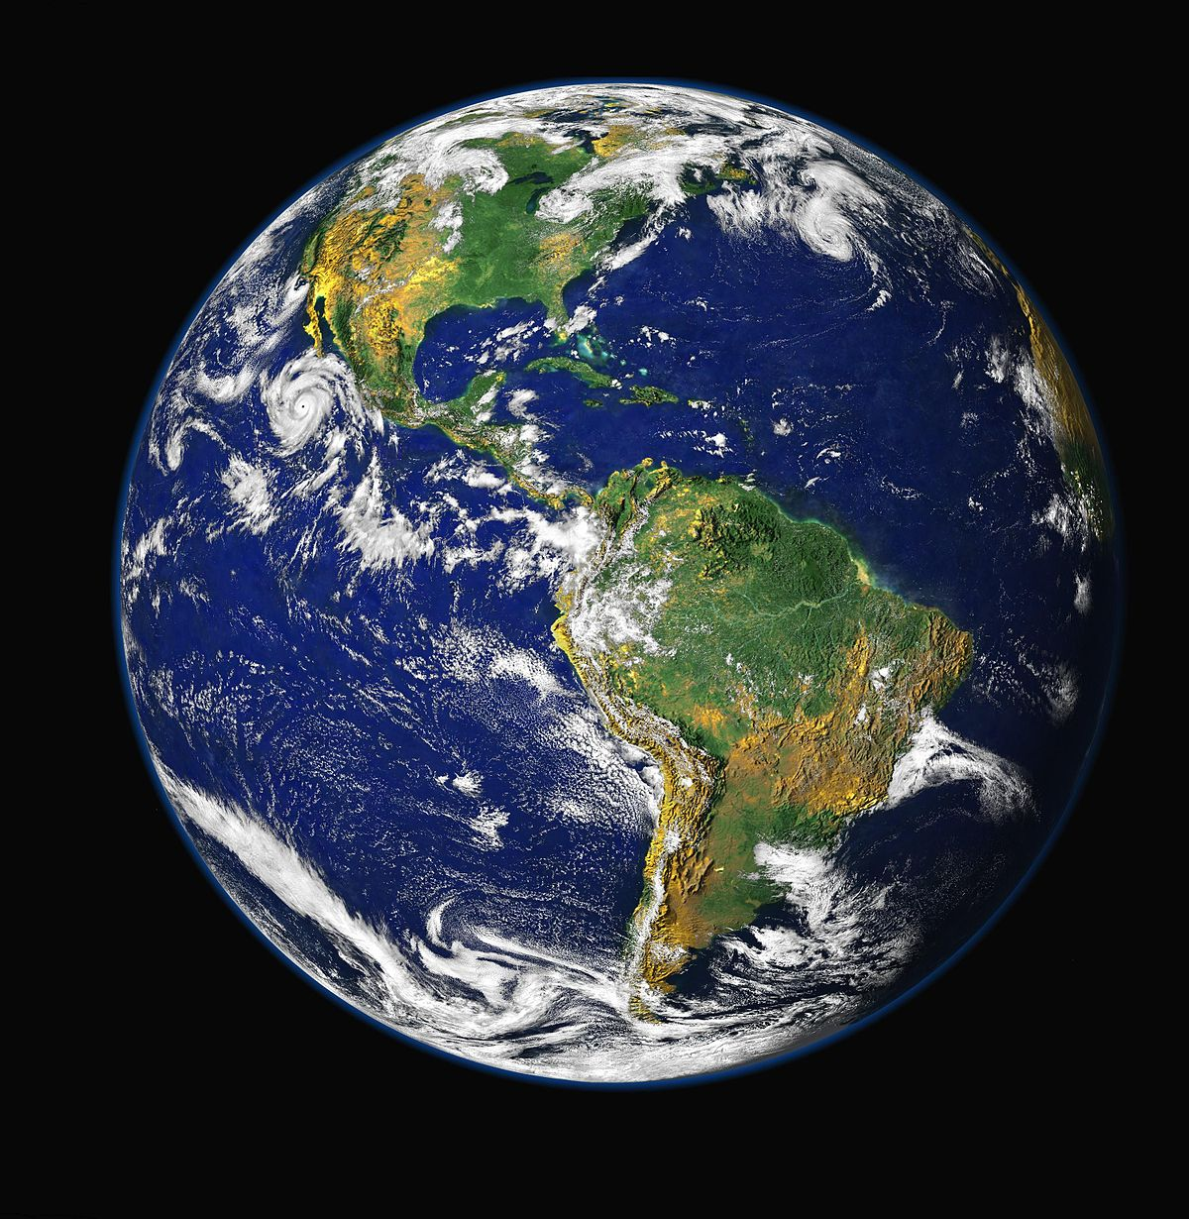
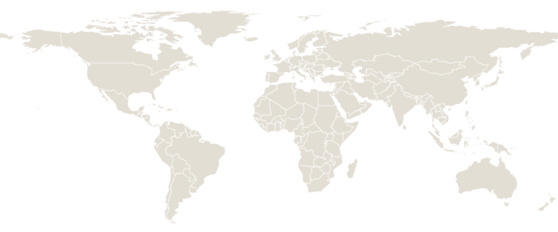
The “global bank” example
Salary paid
Buys Landrover

Slide 8

The trouble with time
No “entity” can know the present state of any other entity

Slide 9
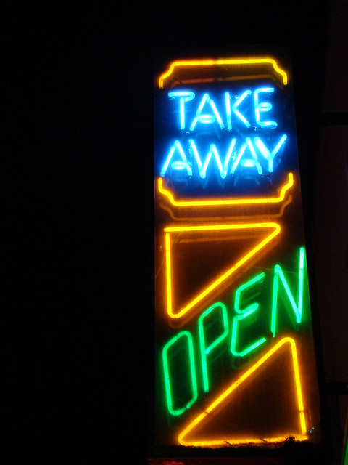
The big take-away
What do you mean by “is”?

